Slide 1
Counters

Slide 2
Introduction: Counters
Counters are circuits that cycle through a specified number of states.
Two types of counters:
synchronous (parallel) counters
asynchronous (ripple) counters
Ripple counters allow some flip-flop outputs to be used as a source of clock for other flip-flops.
Synchronous counters apply the same clock to all flip-flops.

Slide 3
Asynchronous (Ripple) Counters
Asynchronous counters: the flip-flops do not change states at exactly the same time as they do not have a common clock pulse.
Also known as ripple counters, as the input clock pulse “ripples” through the counter – cumulative delay is a drawback.

Slide 4
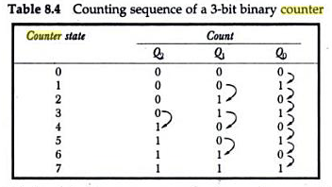
Example: 3-bit ripple binary counter.

Slide 5
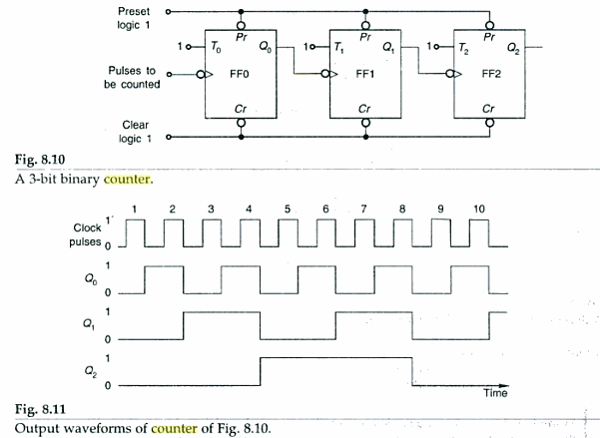

Slide 6
Synchronous (Parallel) Counters
Synchronous (parallel) counters: the flip-flops are clocked at the same time by a common clock pulse.

Slide 7
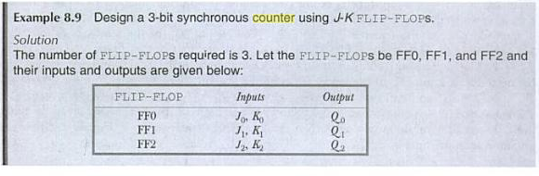
3 bit synchronous counter

Slide 8
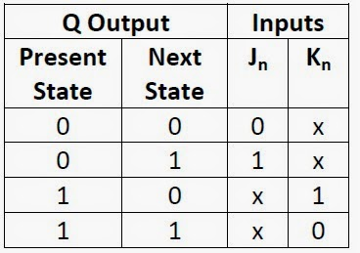

Slide 9
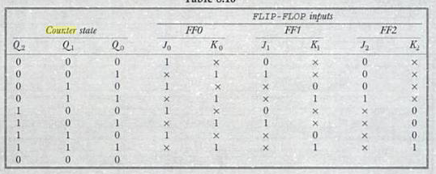
3 bit synchronous counter

Slide 10
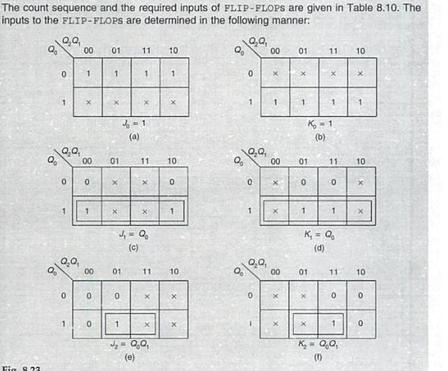
3 bit synchronous counter

Slide 11
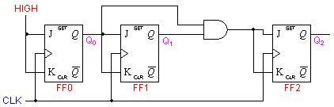

Slide 12
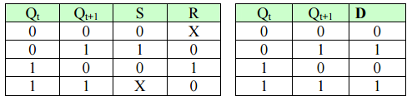
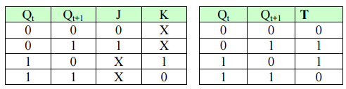

Slide 13
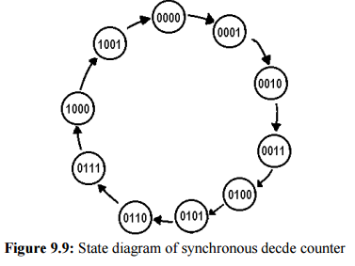
Modulo Counters
Design of a Synchronous Decade Counter Using JK FlipFlop

Slide 14
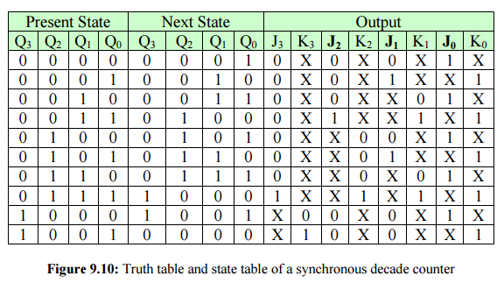

Slide 15
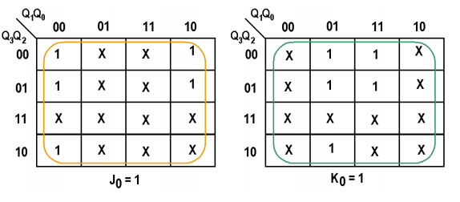
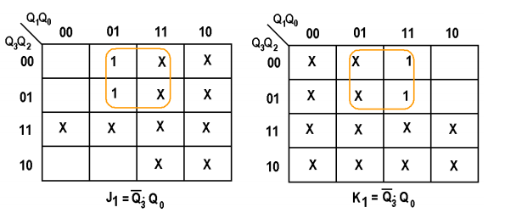

Slide 16
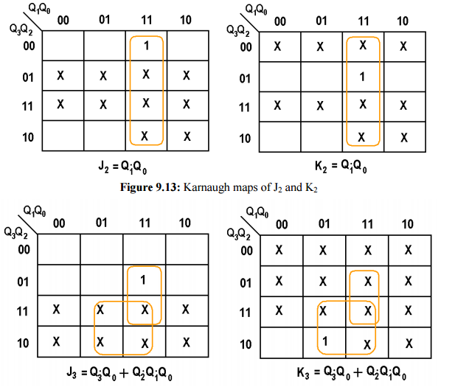

Slide 17
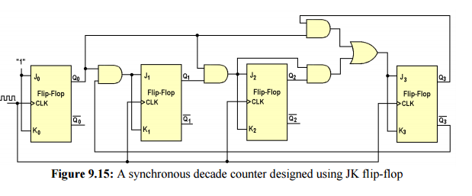

Slide 18
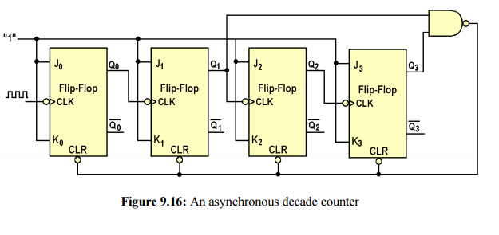
Modulo Counters
Design of an Asynchronous Decade Counter Using JK FlipFlop

Slide 19
Ring Counters
One flip-flop (stage) for each state in the sequence.
The output of the last stage is connected to the D input of the first stage.
An n-bit ring counter cycles through n states.
No decoding gates are required, as there is an output that corresponds to every state the counter is in.

Slide 20
Ring Counters
Example: A 6-bit (MOD-6) ring counter.
PRE
Q₀
Q₁
Q₂
Q₃
Q₄
Q₅
D
Q
D
Q
D
Q
D
Q
D
Q
D
Q
CLR
CLK
100000
000001
010000
000010
001000
000100

Slide 21
Johnson Counters
The complement of the output of the last stage is connected back to the D input of the first stage.
Also called the twisted-ring counter.
Require fewer flip-flops than ring counters but more flip-flops than binary counters.
An n-bit Johnson counter cycles through 2n states.
Require more decoding circuitry than ring counter but less than binary counters.

Slide 22
Johnson Counters
Example: A 4-bit (MOD-8) Johnson counter.
Q₀
Q₁
Q₂
D
Q
D
Q
D
Q
D
Q
Q'
Q₃'
CLR
CLK
0000
0001
1000
0011
1100
0111
1110
1111

